Slide 1











Official (Closed) - Non Sensitive
PROGRAMMING
FUNDAMENTALS
Objects in JS
DIPLOMA IN FULL-STACK DEVELOPMENT
Certificate in Computing Fundamentals
Continuing Education & Training (CET)

Slide 2
OOP
.
.
Object Oriented Programming

Slide 3
DEFINITION
Objects group together a set of variables and functions to create a model
Used to model the real world.

Slide 4

Image source: booking.com

Slide 5
LITERAL OBJECTS
let hotel = {
name: 'Raffles Hotel',
rooms: 100,
booked: 24,
gym: true,
roomTypes: ['twin','suite','delux'],
checkAvailability: function() {
return this.rooms – this.booked;
}
};
KEY / NAME
VALUE
PROPERTIES
These are variables
METHOD
This is a function
Notes:
Literal objects allow us to define various properties at once and easily access them. It is based on a key paired value basis

Slide 6
OBJECT
LITERAL OBJECTS
KEY / NAME
VALUE
let hotel = {
name: 'Raffles Hotel',
rooms: 100,
booked: 24,
gym: true,
roomTypes: ['twin','suite','delux'],
checkAvailability: function() {
return this.rooms – this.booked;
}
};
Object is the curly braces {… } and its contents
Object stored in a variable hotel
Separate each key from its value using a colon
Separate each property and method with a comma
The this keyword in checkAvailability() method,
References the rooms and booked projects of the
Object (hotel)
PROPERTIES
These are variables
METHOD
This is a function
https://replit.com/@immalcolm/js-objects#index.html

Slide 7

let hotelName = hotel.name; let roomsFree = hotel.checkAvailability();
ACCESSING AN OBJECT
OBJECT
PROPERTY/METHOD NAME
MEMBER OPERATOR
let hotelName = hotel['name']; let roomsFree = hotel['checkAvailability']();
https://repl.it/@malcolmyam/wk06-objects#script.js
Notes:
We can access the values using dot notation or the array notation []

Slide 8
hotel.name = 'Favcho Royale Hotel';
UPDATING AN OBJECT
OBJECT
PROPERTY NAME
PROPERTY VALUE
* Note: If the object does not have the property you are trying to update, it will be added to the object
MEMBER OPERATOR
ASSIGNMENT OPERATOR
hotel['name'] = 'Favcho Royale Hotel';
delete hotel.name;
// Delete a property using the delete keyword
hotel.name = '';
// Clear the value of a property by assigning a blank string

Slide 9
OBJECT
CONSTRUCTOR NOTATION
KEY / NAME
VALUE
let hotel = new Object();
hotel.name = 'Raffles Hotel';
hotel.rooms = 100;
hotel.booked = 24;
hotel.gym = true;
hotel.roomTypes = ['twin','suite','delux'];
hotel.checkAvailability: function() {
return this.rooms – this.booked;
}
Create an object using the "new" keyword and the
Object() constructor (Blank object)
Add properties, methods to the newly created blank object
PROPERTIES
METHOD
Notes:
An anonymous object we can create

Slide 10
OBJECT
FUNCTION BASED OBJECTS
KEY / NAME
VALUE
PARAMETERS
function Hotel(name, rooms, booked){
this.name = name;
this.rooms = rooms;
this.booked = 24;
this.checkAvailability = function() {
return this.rooms – this.booked;
};
}
Creating a function Hotel allows it to be used as a template for creating multiple objects
This is called a function based object.
The this keyword is used instead of the object name to indicate the property/method belongs to the object that this function creates.
Each statement creates a new property or method. Uses semi-colon instead of comma (literal object syntax)
PROPERTIES
METHOD
https://replit.com/@immalcolm/js-objects#script.js
Notes:
Function based objects allows use to create a “template” to allow multiple objects to be created easily.

Slide 11
let favchoHotel = new Hotel('Favcho Hotel', 100, 25);
MULTIPLE OBJECT INSTANCES
OBJECT
CONSTRUCTOR FUNCTION
let lizzieHotel = new Hotel('Lizzie Inn', 48, 12);
ASSIGNMENT OPERATOR
NEW KEYWORD
VALUES USED IN PROPERTIES OF THIS OBJECT
The first object favchoHotel. Name is "Favcho Hotel".
100 rooms, 25 booked
The second object lizzieHotel. Name is "Lizzie Inn".
48 rooms, 12 booked
* Note: Even when multiple objects are created using the same constructor function, the methods stay the same.
https://replit.com/@immalcolm/js-objects#script.js

Slide 12
PROPERTIES:
KEY
VALUE
name
string
rooms
number
booked
number
gym
boolean
roomTypes
array
METHODS:
checkAvailability
function
Objects consist of a set of key/value pairs (key can be referenced as name)

Slide 13
LITERAL OBJECTS
FUNCTION-BASED
OBJECTS
Has no constructors
Cannot be inherited
Best used for “one off” objects where only one copy will exist
A colon separates the key/value pair
For global or configuration objects like 'game settings'
Has a constructor
Can be inherited (but very messy, out of scope here)
Best use for stuff that you want to instantiate again and again)
The this keyword is used instead of the object name
If you have lots of objects with similar functionality
Notes:
A constructor is a function that creates an instance of a class which is typically called an “object”.
In JavaScript, a constructor gets called when you declare an object using the new keyword.
The purpose of a constructor is to create an object and set values if there are any object properties present.
It’s a neat way to create an object because you do not need to explicitly state what to return as the constructor function, by default,
returns the object that gets created within it.

Slide 14
ACTIVITY
“Objects” (30min)
OVERBAE
In a fictional Karaoke Party game called "OverBae", there are singers and judges. One singer character "momobae" has the following properties:
Name: Momobae
Specialty: K-Pop
Power: 49
Hitpoints: 28
Level: 7
Gender: Female
a.) Create a literal object variable named "momobae" that contains the above properties. For each property, indicate the appropriate data types to use.
b.) Create a function-based object method named "Singer" that is able to fulfil the above properties. Indicate the constructor, parameters, variables used in your function.
Create a method for your function object that calculates their maximum power.
This is formulated by power multiplied by level minus the current hit points.
Create a method "singerProfile" to allow printing of the singer statistics. Use template literals to help in your code. It should read as follows:
“Momobae Level 7, gender Female, specialty ‘K-Pop’.
Power 49! Hitpoints: Weak.”
Create two new singer object variable "momobae" and “minabae” using the function based object you created. You may assume your values for your properties.
The hitpoints reference chart are to be followed:
<=50 = Weak
51-70 = Strong
71-100 = Amazing

Slide 15
ACTIVITY
“Objects” (20min)
c. Create an array to store your two new singers. Write a loop function to print out the "singerProfile" of each singer.
d. (Challenge)
Suggest additional useful properties for your objects. Or think about how you can use judges in this scenario.

Slide 16
VAR, LET, CONST
Understanding Scoping

Slide 17
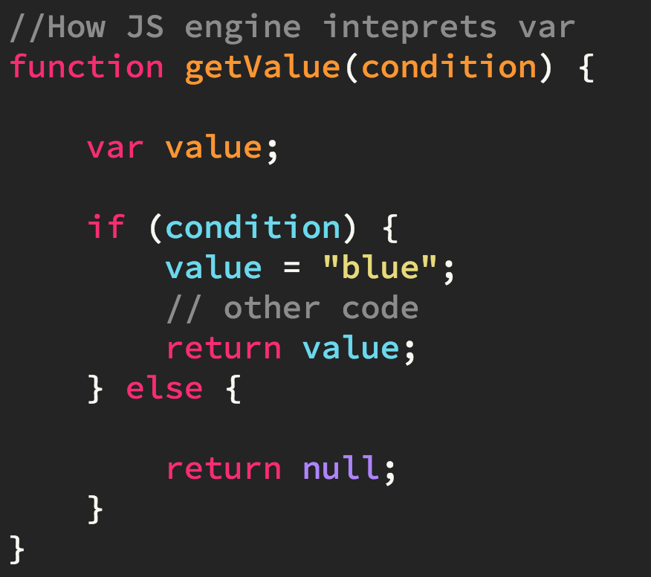
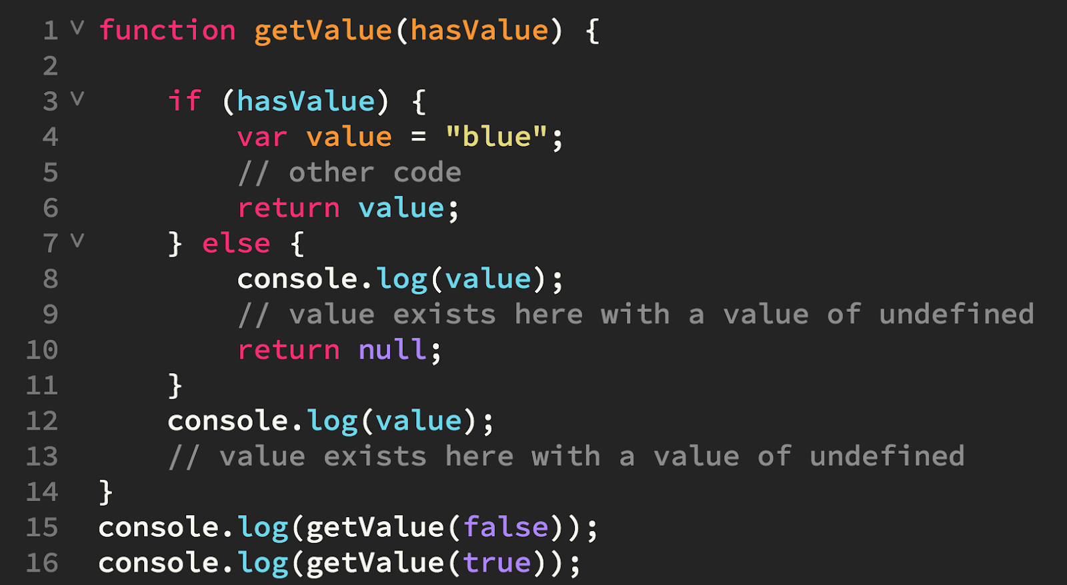
VARIABLE DECLARATION & HOISTING
//hoisting happening
*NOTE:
Variable declarations using var are treated as if they are at the top of the function (or global scope, if declared outside of a function) regardless of where the actual declaration occurs; this is called hoisting.
The scope of a variable defined with var is function scope or declared outside any function, global.
Further Reading Reference: https://developer.mozilla.org/en-US/docs/Web/JavaScript/Reference/Statements/let

Slide 18
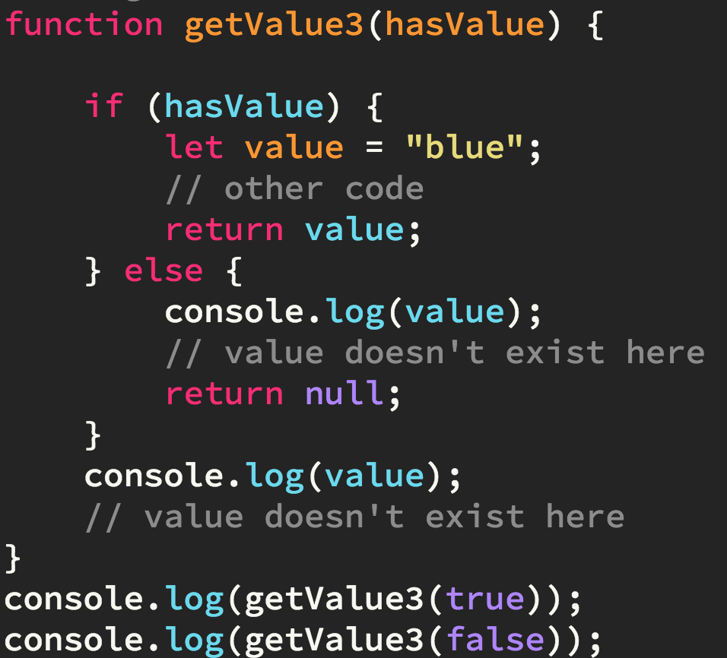
LET
value only exists here
let declarations are not hoisted to the top of the enclosing block
let is block-scoped meaning it only exist within the braces it is contained in {…}
Further Reading
https://www.w3schools.com/js/js_let.asp
Notes:
ES2015 introduced two important new JavaScript keywords: let and const.
These two keywords provide Block Scope variables (and constants) in JavaScript.
Before ES2015, JavaScript had only two types of scope: Global Scope and Function Scope.

Slide 19
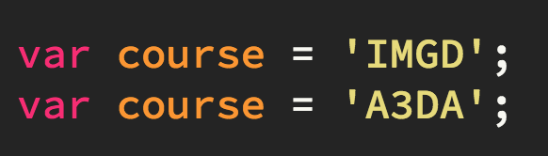
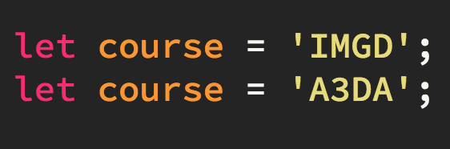
VAR vs LET: Declarations
var allows us to re-declare a variable
let does not allow us to re-declare a variable.

Slide 20
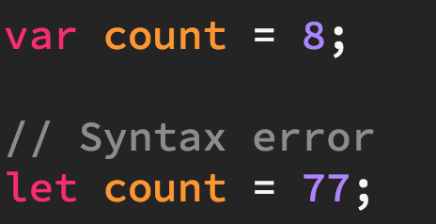
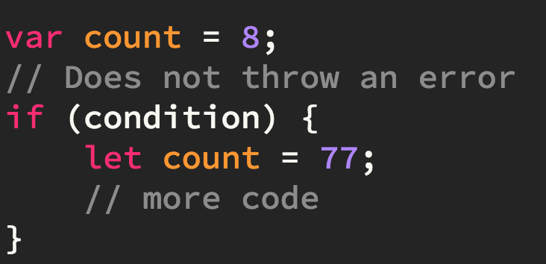
LET: NO REDECLARATION
If an identifier has already been defined in a scope, then using the identifier in a let declaration inside that scope causes an error to be thrown.
In this case, count has already been declared using var. The let declaration will throw up a syntax error. Because let will not redefine another variable that is in the same scope.
The let variable in this case creates a new variable with the same name as a variable within its scope if…..{…}

Slide 21
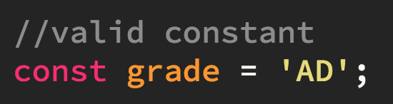
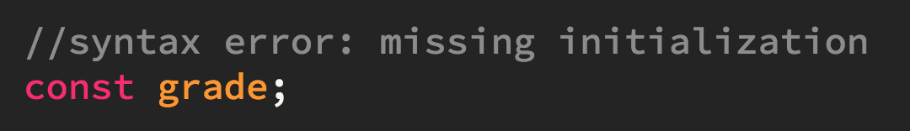
CONST
Variables declared using const are considered constants, meaning their values cannot be changed once set.
For this reason, every const variable must be initialized on declaration

Slide 22
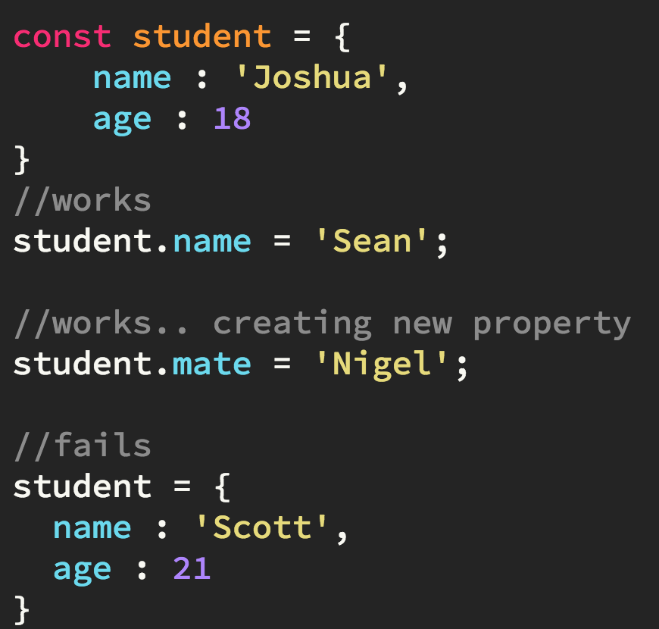
Declaring Objects using const
The binding student is created with an initial value of an object with two properties.
It’s possible to change student.name without causing an error because this changes what student contains and doesn’t change the value that person is bound to. It is also possible to create additional properties for the object.
Code fails when we assign student to a new value (changing the information that it is bound to).
A const declaration prevents modification of the binding and not of the value itself.

Slide 23
For…of
ES6 Loop

Slide 24
for (let expense of dailyExpenses){ expense *= 2; console.log("Expense:" + expense); }
Example: Display the word "Expense: x" using for ..of loop
let dailyExpenses = [29, 81, 43];
KEYWORD
VARIABLE
ITERABLE
Output
Expense: 58
Expense: 162
Expense: 86
CODE TO EXECUTE DURING LOOP (INSIDE THE LOOP)
The for...of statement creates a loop iterating over iterable objects
- Array, Map, Set, String, TypedArray, arguments
CLOSING
CURLY BRACE
(END OF LOOP)
*Reference Article
https://developer.mozilla.org/en-US/docs/Web/JavaScript/Reference/Statements/for...of
Notes:
expense *= 2 shorthand for expense = expense*2

Slide 25

DATA FORMATS JSON
Official (Closed) - Non Sensitive
#WEBSTORAGE
Notes:
JSON stands for JavaScript Object Notation
JSON is a lightweight format for storing and transporting data
JSON is often used when data is sent from a server to a web page
JSON is "self-describing" and easy to understand

Slide 26
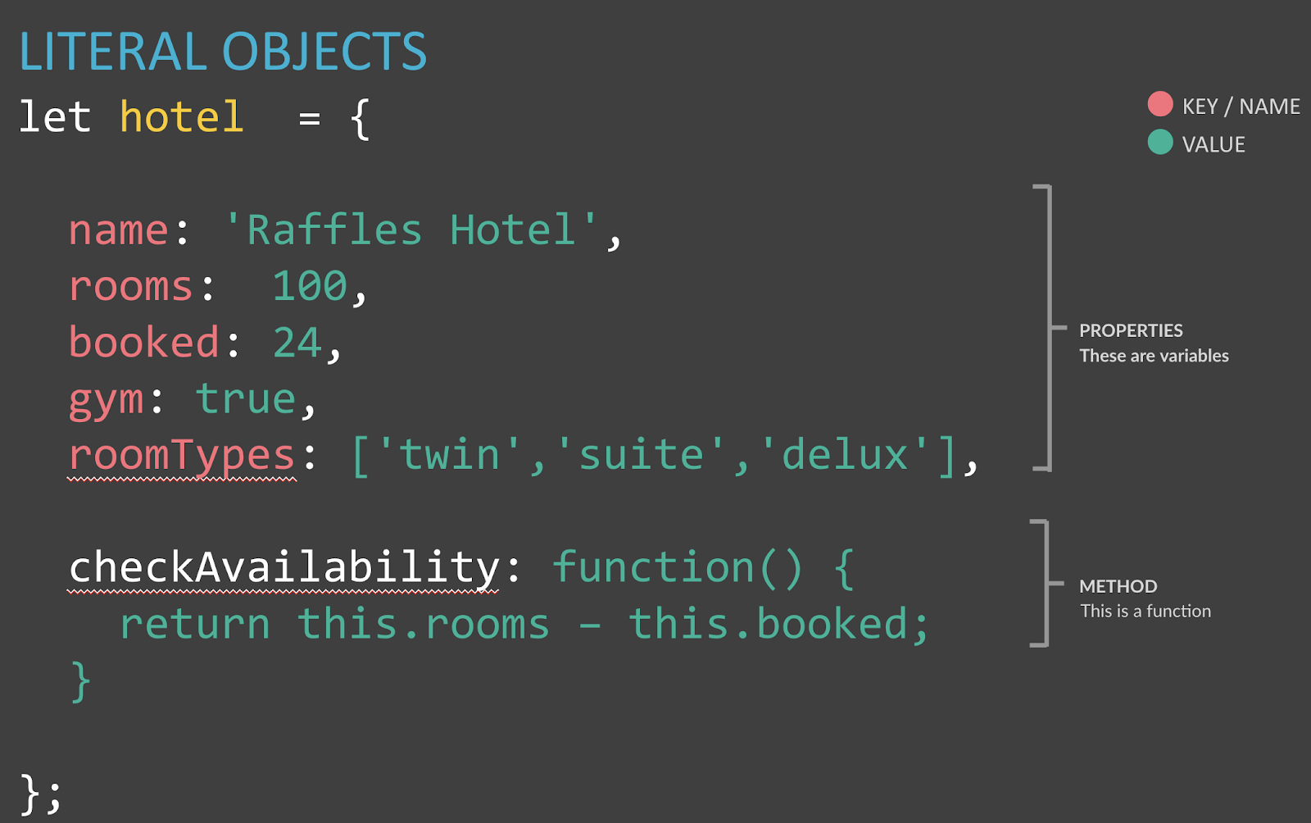
JSON looks like object literal syntax but it is just data, not an object:
{ "name": "Pikachu", "hp": 200, "attack": 999, "defense": 999, "type": "electric" }
Official (Closed) - Non Sensitive
https://www.w3schools.com/js/js_json_intro.asp
https://developer.mozilla.org/en-US/docs/Web/JavaScript/Reference/Global_Objects/JSON
Notes:
This is the JSON syntax. Prounced JASON
JSON is a syntax for serializing objects, arrays, numbers, strings, booleans, and null. It is based upon JavaScript syntax but is distinct from it: some JavaScript is not JSON.
Property names (in red) must be double quotated strings
You could have an array in JSON but it has to be in JSON syntax
Arrays in JSON
{
"employee":{ "name":"John", "age":30, "city":"New York" }
}
https://developer.mozilla.org/en-US/docs/Web/JavaScript/Reference/Global_Objects/JSON
https://www.w3schools.com/js/js_json_intro.asp
https://www.w3schools.com/js/js_json_datatypes.asp

Slide 27
{ "name": "Pikachu", "hp": "200", "attack": "999", "defense": "999", "type": "electric" }
Official (Closed) - Non Sensitive
JSON data is made up of keys and values:
In JSON, the key should be placed in double quotes (not single quotes).
The key (or name) is separated from its value by a colon.
Each key/ value pair is separated by a comma. However, note that there is no comma after the last key/value pair
KEY in double quotes
Unlike your typical literal objects
VALUE
Notes:
JSON is a type of data format that is versatile to use
JSON data format allows us to have more information stored into our localstorage

Slide 28
The value can be a string, number, Boolean, array, object or null. You can nest objects.
Official (Closed) - Non Sensitive

Slide 29


[ { "name":"Pikachu", "hp":100,"attack":9, "defense":8, "color":"yellow", "type":"electric" }, { "name":"squirtle", "hp":"47", "attack":"39", "defense":"38", "color":"blue", "type":"water" } ]
Official (Closed) - Non Sensitive
let pokemon =
NESTING OBJECTS with JSON
pokemon[0].name //pikachu
pokemon[1].name //squirtle
Object
Object
Image Source: http://pokemon.wikia.com/wiki/

Slide 30


JS Basics
Summary
What have we covered?
Literal objects & Function Based Objects
For … of loop
ID

Slide 31
JS Basics
Key Takeaway?
Practise & Practise
Use the Dev Tools/Debugger provided by the browser
ID

